Slide 1
CASE STUDY – C++ APPLICATIONS SECURITY HARDENING
Carnegie Mellon Software Engineering Institute
https://wiki.sei.cmu.edu/confluence/pages/viewpage.action?pageId=88046682

Slide 2
CASE STUDY – C++ APPLICATIONS SECURITY HARDENING
1. Identify critical assets (& asset owner)
2. Research on applicable security controls
3. Checklist of applicable controls
5. Implement controls on test setup
4. Document controls into SOP
6. Validation of control implementation
7. Change management process for PROD
8. Implement on PROD & monitor

Slide 3
CASE STUDY – C++ APPLICATIONS SECURITY HARDENING
Rule 01. Declarations and Initialization (DCL)
Rule 02. Expressions (EXP)
Rule 03. Integers (INT)
Rule 04. Containers (CTR)
Rule 05. Characters and Strings (STR)

Slide 4
CASE STUDY – C++ APPLICATIONS SECURITY HARDENING
Rule 06. Memory Management (MEM)
Rule 07. Input Output (FIO)
Rule 08. Exceptions and Error Handling (ERR)Page:
Rule 09. Object Oriented Programming (OOP)
Rule 10. Concurrency (CON)

Slide 5
CASE STUDY – C++ APPLICATIONS SECURITY HARDENING
Rule 10. Concurrency (CON)
CON50-CPP. Do not destroy a mutex while it is locked

Slide 6
CASE STUDY – C++ APPLICATIONS SECURITY HARDENING
Mutex objects are used to protect shared data from being concurrently accessed. If a mutex object is destroyed while a thread is blocked waiting for the lock, critical sections and shared data are no longer protected.

Slide 7
CASE STUDY – C++ APPLICATIONS SECURITY HARDENING
The C++ Standard, [thread.mutex.class], paragraph 5 [ISO/IEC 14882-2014], states the following:
The behavior of a program is undefined if it destroys a mutex object owned by any thread or a thread terminates while owning a mutex object.

Slide 8
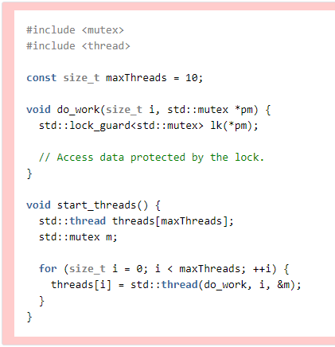
CASE STUDY – C++ APPLICATIONS SECURITY HARDENING

Slide 9
CASE STUDY – C++ APPLICATIONS SECURITY HARDENING
Non-Compliant Code Example:
This noncompliant code example creates several threads that each invoke the do_work() function, passing a unique number as an ID.
Unfortunately, this code contains a race condition, allowing the mutex to be destroyed

Slide 10
CASE STUDY – C++ APPLICATIONS SECURITY HARDENING
…while it is still owned, because start_threads() may invoke the mutex's destructor before all of the threads have exited.

Slide 11
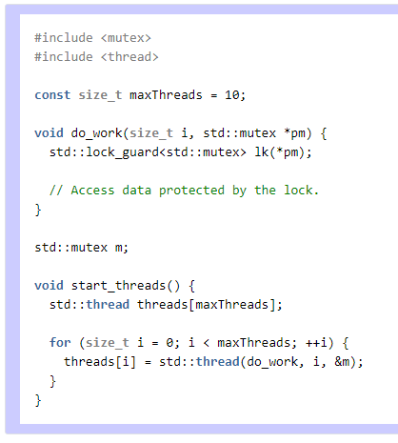
CASE STUDY – C++ APPLICATIONS SECURITY HARDENING

Slide 12
CASE STUDY – C++ APPLICATIONS SECURITY HARDENING
Compliant Code Example:
This compliant solution eliminates the race condition by extending the lifetime of the mutex.
END

